Slide 1

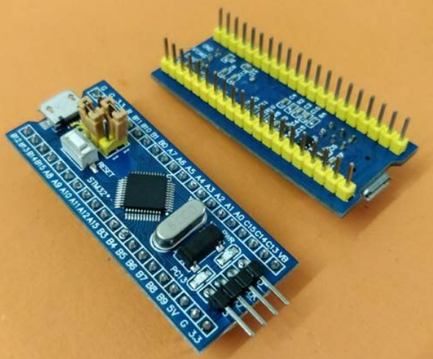
TITLE:
GENERAL PURPOSE INPUT/OUTPUT (GPIO) PINS
Course name :
Microprocessor and Microcontroller
Presented by :
Plabon Dey-2210776118
Md. Akibuzzaman-2210976128
Md. Ruhul Amin-2210776147
Mahfuzur Rahman-2110976149

Slide 2

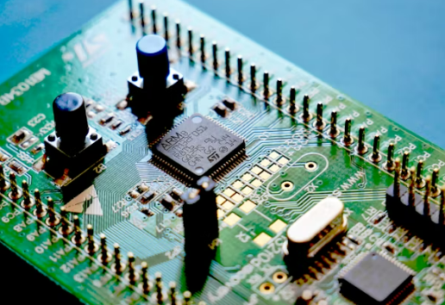
Introduction to GPIO
GPIO stands for General Purpose Input/Output, which are programmable pins on a microcontroller used to interact with external devices.
Key Points:
GPIO pins can send or receive digital signals.
They connect the microcontroller to external hardware.
Each pin can be controlled individually using software.
Purpose:
Allows communication between the microcontroller and external components.

Slide 3
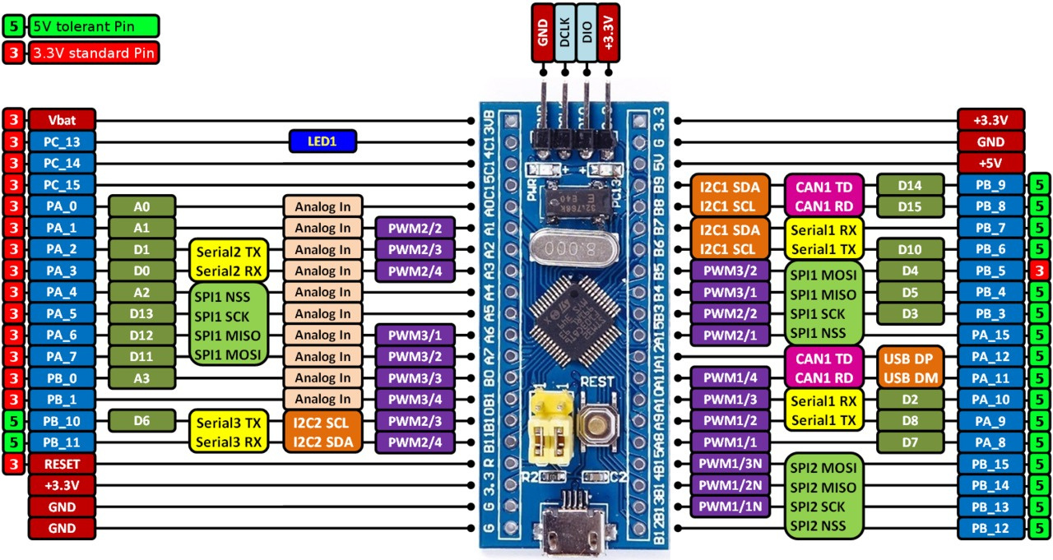
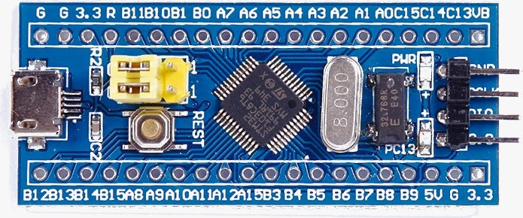
Block Representation of the STM32F103C8T6 Microcontroller Built on the ARM Cortex-M3 Architecture.

Slide 4
GPIO Ports and Pins in STM32
GPIO pins are organized into ports.
Available Ports
GPIOA, GPIOB, GPIOC, GPIOD, GPIOE
Each port contains 16 pins.
Each pin is identified by port name and number.
Example:
PA0, PA1, PA2 … PA15
PB0, PB1, PB2 … PB15
Each pin can be configured independently.

Slide 5
GPIO Operating Modes
GPIO pins support four main modes:
Input Mode – Reads signals from external devices
Output Mode – Sends signals to external devices
Alternate Function Mode – Used for communication peripherals
Analog Mode – Used for analog signal processing
These modes provide flexibility in hardware interfacing.

Slide 6
Input Mode
Purpose:
Used to receive signals from external devices.
Applications:
Reading button input
Receiving sensor signals
Detecting digital signals
Example:
Button pressed → GPIO reads HIGH
Button released → GPIO reads LOW
This allows the microcontroller to detect external events.

Slide 7
Output Mode
Purpose:
Used to send signals to external devices.
Applications:
LED control
Relay control
Motor control
Example:
Example:
GPIO HIGH → LED ON
GPIO LOW → LED OFF
This allows the microcontroller to control external hardware.

Slide 8

Alternate Function and Analog Mode
Alternate Function Mode
Used when GPIO works with internal peripherals such as:
UART ,SPI ,I2C ,Timers ,PWM
Example:
PA2 → UART Transmit
Analog Mode
Used for analog signal processing.
Example:
Reading sensor voltage using ADC

Slide 9
Pull-Up, Pull-Down and Output Types
Pull-Up and Pull-Down Resistors:
Used to ensure stable input signals.
Pull-Up → Default HIGH
Pull-Down → Default LOW
Output Types:
Push-Pull:
Standard output
Used for LEDs and general output
Open-Drain:
Used for communication protocols like I2C

Slide 10
GPIO Applications and Example
Common Applications:
LED control
Button input
Sensor interfacing
Communication interfaces
Motor control
Example:
Steps:
Configure GPIO pin as output
Set pin HIGH → LED ON
Set pin LOW → LED OFF

Slide 11

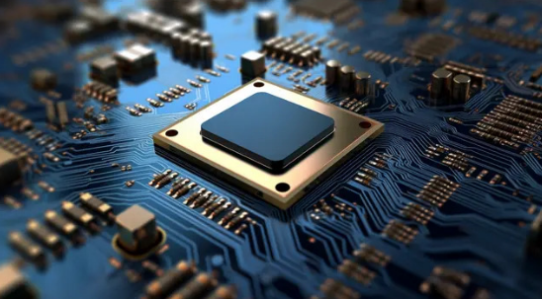
Conclusion
GPIO pins are essential for microcontroller operation.
They allow communication with external devices.
GPIO supports multiple modes for different applications.
GPIO is widely used in embedded systems for control and interfacing.

Slide 12

Thank you
Presented by :
Plabon Dey-2210776118
Md. Akibuzzaman-2210976128
Md. Ruhul Amin-2210776147
Mahfuzur Rahman-2110976149

